Slide 1
Red Cell Indices
Dr N.O Ogidi

Slide 2
Outline
Introduction
Mean Corpuscular Volume
Mean Corpuscular Haemoglobin
Mean Corpuscular Haemoglobin Concentration
Red Cell Distribution Width
Colour Index

Slide 3
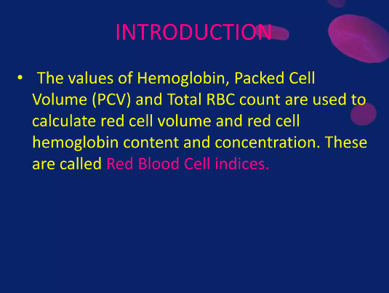

Slide 4
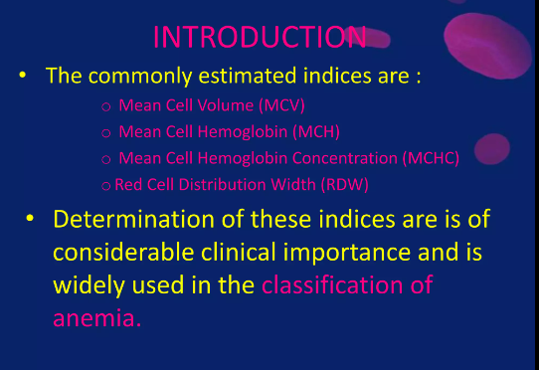

Slide 5
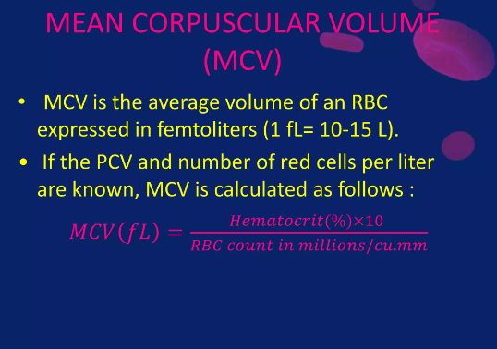

Slide 6
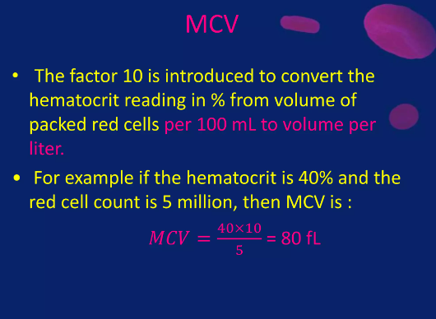

Slide 7
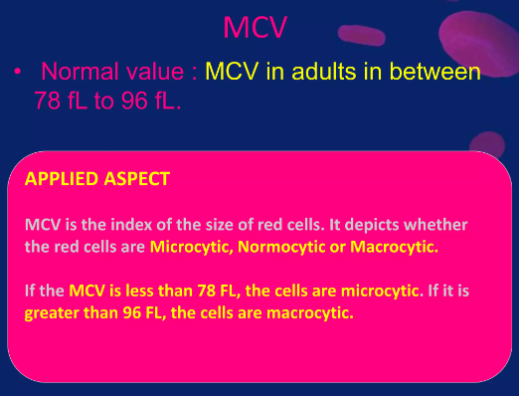

Slide 8
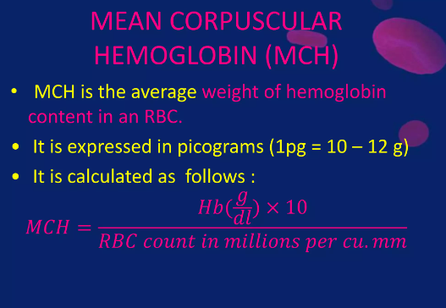

Slide 9
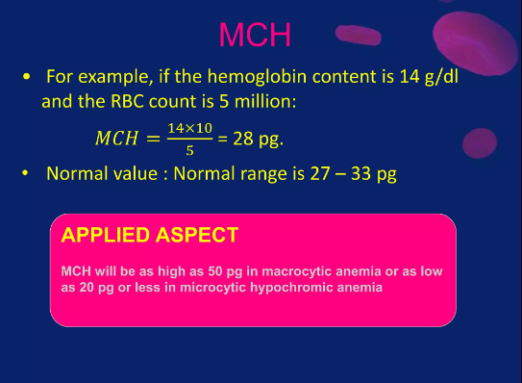

Slide 10
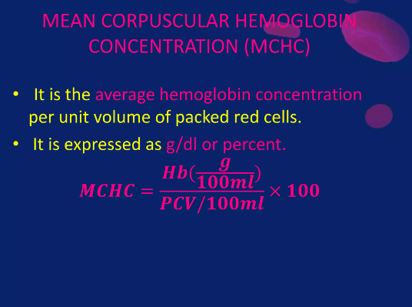

Slide 11
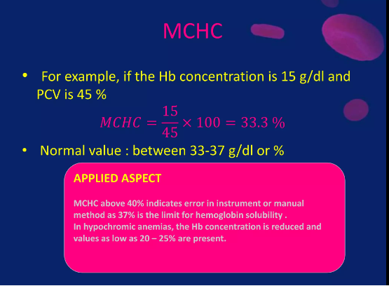

Slide 12
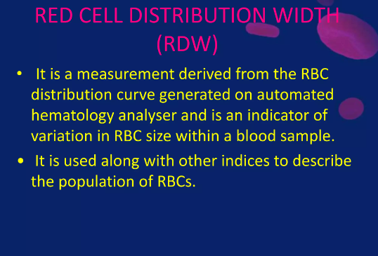

Slide 13
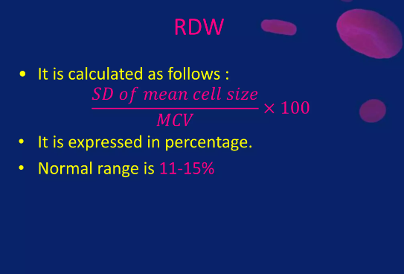

Slide 14
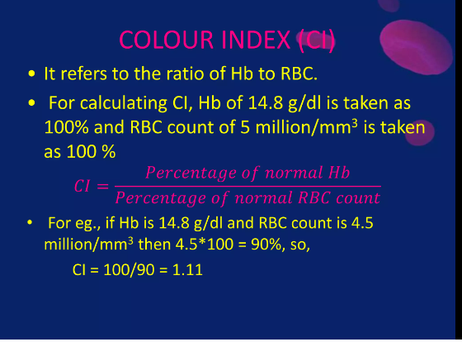

Slide 15


